Slide 1

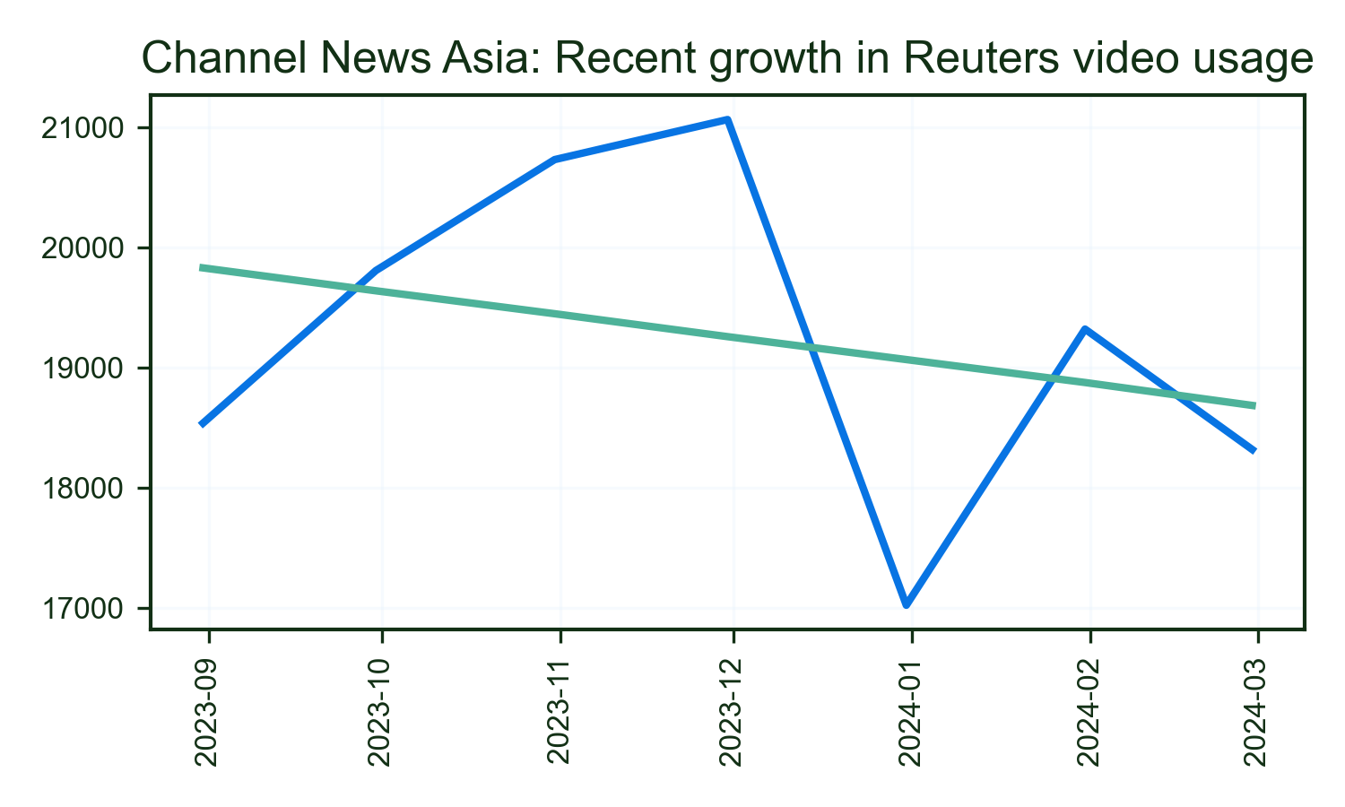
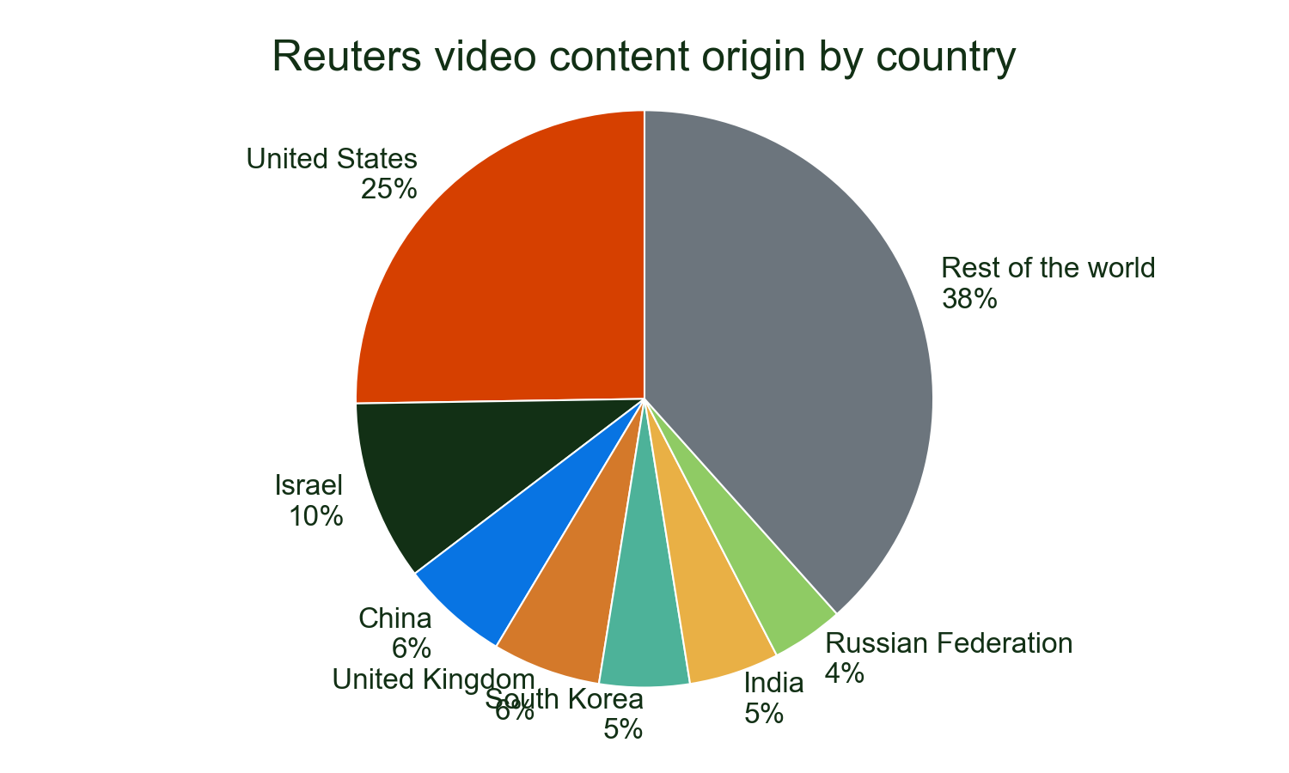
Channel News Asia has shown strong growth in Reuters video usage, with a 16% increase in the most recent month.
Their coverage prominently features Reuters video from Pan Asia and other key regions, demonstrating the global reach of our partnership.
Major stories
• ISRAEL: 18.1%
• USA: 14.2%
• SOUTHKOREA: 5.4%
Of all detections of Reuters video on Channel News Asia in 2024.

